Slide 1
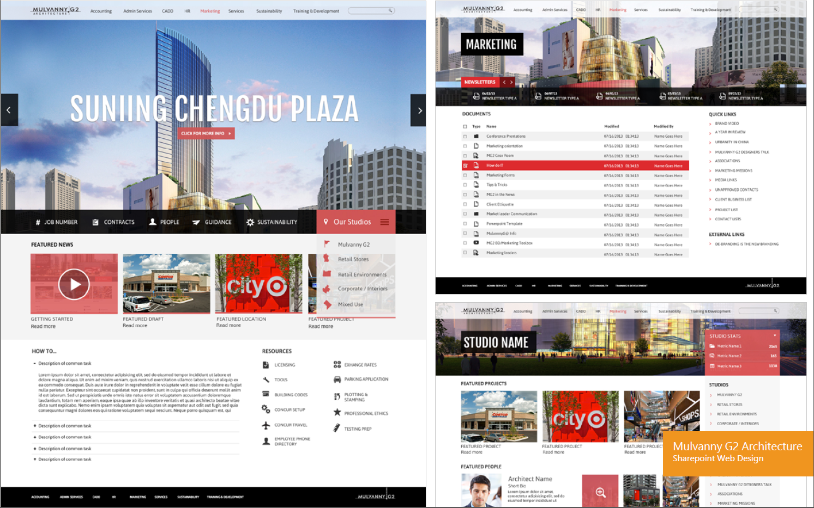
MG2 Architecture – Global Collaboration SharePoint Site
Business Need
MulvannyG2 Architecture came to us needing a new SharePoint design site. The client’s existing system gathered content from multiple sites and applications, so they wanted a way to organize all their day-to-day needs into one centralized location. They also wanted us to create a community-like experience within the site that would showcase designers within the studios, displaying the designers’ strengths, helping project management and overall workflow.
What We Did
We went through group sessions with Mulvanny to understand key functionality to implement new ideas and forward thinking methods. Utilizing best practices, we designed highly intuitive wireframes that allowed us to quickly visualize functionality while ensuring a great user experience.
While working thoroughly with Mulvanny in design focused meetings; we created a modern yet classic design. We took elements of their brand to maintain a consistent look with all of the existing collateral. We used full width images of their designs within the site, which served as a way to showcase the designers’ work as well.

Slide 2
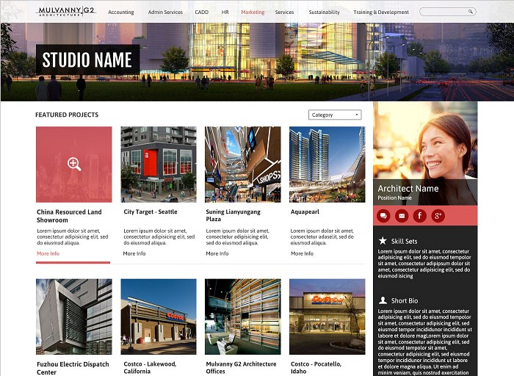
MG2 Architecture – Global Collaboration SharePoint Site

